Slide 1
CREDIT CARD DEFAULT PREDICTION
Detailed Project Report (DPR)
Manisha Singh

Slide 2
Contents
Objective
Data Description
Architecture
Model Training and Evaluation Workflow
Deployment

Slide 3
Objective
The primary objective of this project report is to develop an accurate and reliable credit card default prediction model using advanced machine learning techniques.
The report aims to analyze historical credit card transaction data and associated customer attributes to build a predictive model that can identify and classify potential defaulters.
By achieving this objective, the project aims to provide valuable insights to financial institutions, enabling them to make informed decisions regarding risk assessment, credit limit determination, and proactive customer management.
The report will also explore the impact of various features and factors on the prediction accuracy, contributing to the broader understanding of credit risk assessment in the financial industry.

Slide 4
Data Description
The dataset contains information on default payments, demographic factors, credit data, history of payment, and bill statements of credit card clients in Taiwan from April 2005 to September 2005. There are 25 variables in this dataset.

Slide 5
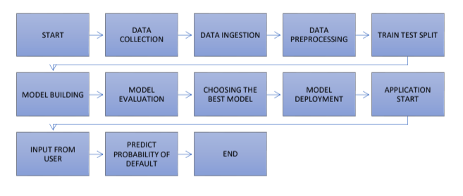
Architecture

Slide 6
Data Exploration:
We divide the data into two types: numerical and categorical. We explore through each type one by one. Within each type, we explore, visualize and analyze each variable one by one and note down our observations. We also make some minor changes in the data like change column names for convenience in understanding.
Feature Engineering:
Encoded categorical variables.
Engineering new features

Slide 7
Train/Test Split:
Split the data into 80% train set and 20% test set.
Model Building:
Built models and trained and tested the data on the models.
Compared the performance of each model and selected the best one.
Save the model:
Saved the model by converting into a pickle file.
Application Start and Input Data by the User:
Start the application and enter the inputs.

Slide 8
Prediction:
After the inputs are submitted the application runs the model and
makes predictions. The out is displayed as a message indicating
whether the customer whose demographic and behavioral data are
entered as inputs, is likely to default in the following month or not.

Slide 9
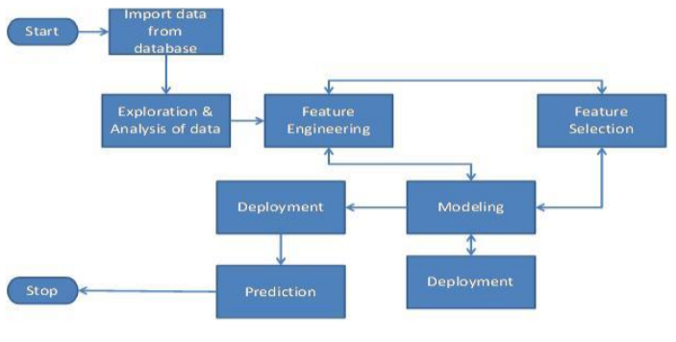
Model Training and Evaluation Workflow

Slide 10
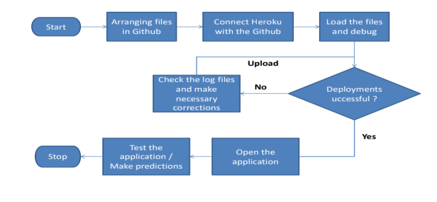
Deployment

